Slide 1

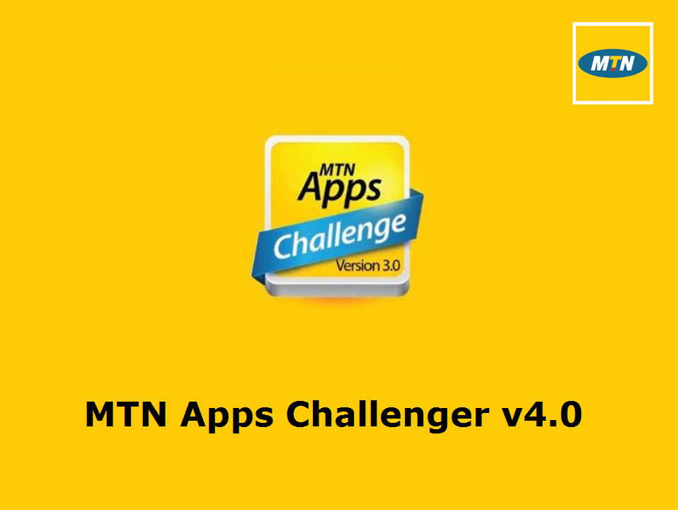
App Name: Yennkasa
Category: Freelance
<number>

Slide 2
Introduction of Team Members
Name:Aminu Abdul Manaf
Email: afolanyaaminu@gmail.com
Phone No. 0266349205
Name:
Email
Phone No.
Name:
Email
Phone No.
Institution: Freelance
Supervisor:
Location/City:Ho
<number>

Slide 3
Problem Statement
Instant messaging is not a new thing, unfortunately for the long time it has been around, users still have very limited control of their conversations with their loved ones or if they have at all, can do very little even with today’s powerful phones, better networking and software platform support.
“BRINGING CONVERSATIONS TO LIFE”
<number>

Slide 4
Concept
Yennkasa is a re-think of Instant messaging from the ground up. It’s built with the conversations people have in the real world in mind. But it does not carry along their pesky real world limitations. It attempts to do what is expected of an instant messenger Today.
“BRINGING CONVERSATIONS TO LIFE”

Slide 5
How the app works
WITH YENNKASA MESSENGER USERS CAN
Text loved ones securely and quickly
Voice/video call their best friends
Powerful group messaging support
Cancel sending messages
Revert sent messages until they are read
Edit sent messages
Lock sensitive conversations. No need for 3rd party apps.
Block users
Backup their conversations safely and passively in the cloud
Export conversations in readable formats like html and pdf not just raw text!
Send any file type
Find new people who are not in their address book to start conversations.
Multi-Device support
Have fun and so many more………
“BRINGING CONVERSATIONS TO LIFE”
<number>

Slide 6
How the app works
In Yennkasa Messenger almost everything is contained in a Conversation.
In a conversation users can exchange
Calls (video/voice)
Text
Media
And other arbitrary file types.
“BRINGING CONVERSATIONS TO LIFE”
<number>

Slide 7
Users of Yennkasa MESSENGER can start conversation in three major ways
By selecting an entry from their contacts
By searching for other users and start conversation with them
By sending a link which the other party can click and start a conversations provided they have the app installed
“BRINGING CONVERSATIONS TO LIFE”
<number>

Slide 8
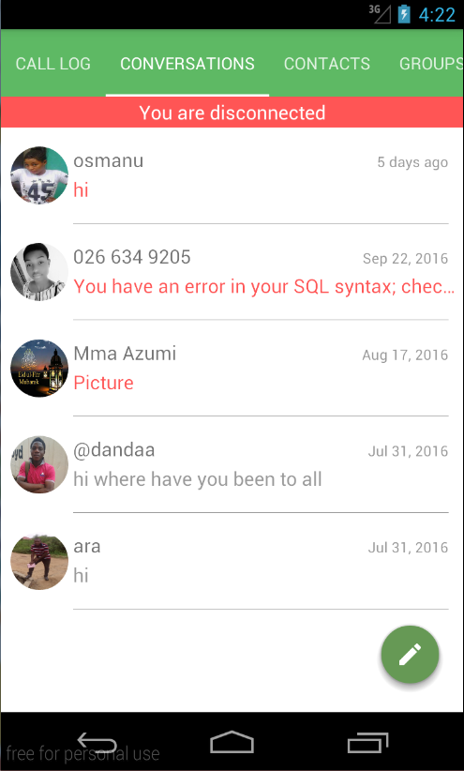
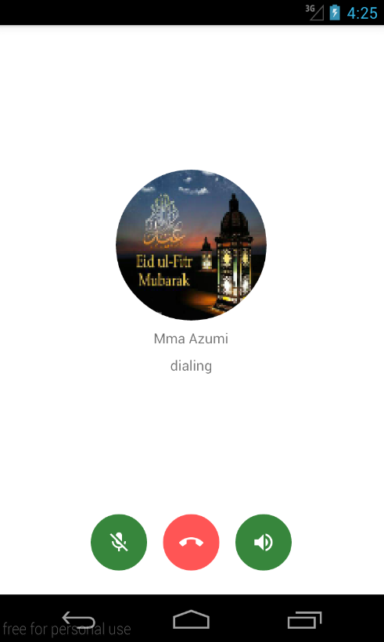
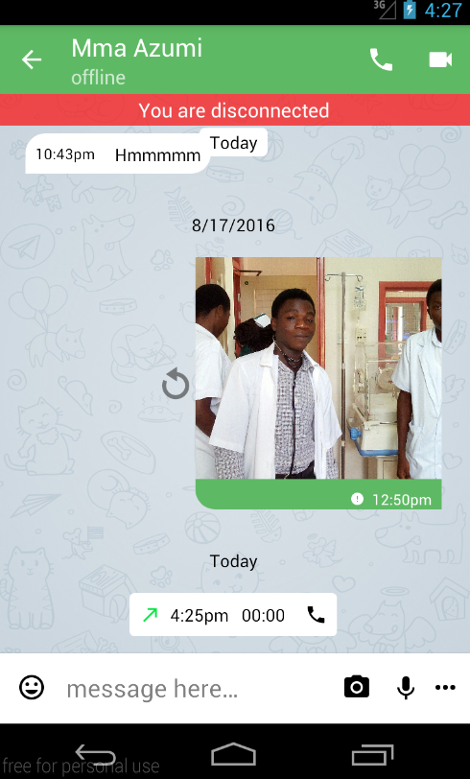
Screenshots
Conversations
Call Screen
Chat Room
“BRINGING CONVERSATIONS TO LIFE”
CONFIDENTIAL
Notes:
<number>

Slide 9
Technical Details
Programming Languages
Our server stack is written in JavaScript and Java.
The android client is written in Java and C/C++.
Hardware And Software Requirements
Available only on Android.
All devices running android 2.3 or later are supported.
Currently Optimized for touchscreen phones
Camera and microphone needed to use the calling features.
…..and support For other platforms coming soon.
“BRINGING CONVERSATIONS TO LIFE”
CONFIDENTIAL
Notes:
<number>

Slide 10
Target Customers
All human beings who want to get in touch with their loved ones or meet new friends around the world.
“BRINGING CONVERSATIONS TO LIFE”
CONFIDENTIAL
Notes:
<number>

Slide 11
Business Case
The application is a freemium.
Currently we plan on generating income through:
Sane advertisement.
Premium features like sending larger files (over 32MB).
Providing a high traffic and automated(with bots) customer support solutions for larger enterprises.
We hope we are able to come up with more income generating ideas.
Our prime aim is to introduce a new trend in instant messaging that meets today’s and the future’s requirement.
“BRINGING CONVERSATIONS TO LIFE”
<number>

Slide 12
Conclusion
With networking becoming faster, smartphones getting smarter and more powerful and people daring more to connect to their loved ones and new people like never before, we jump into the old and saturated instant messaging market to provide them the solution they really need to make this dream easier to realize without a single unreasonable restriction. We make it FUN and keep these conversations and moments safe so that they may never lose them when they don’t want to.
“BRINGING CONVERSATIONS TO LIFE”
<number>

Slide 13
Thank You
<number>

